Slide 1
NAVTTC – National Vocational and
Technical Training Commission
DATA ANALYTICS
Instructors: Enayat Raza (MS Data Science, NEDUET) Umair Baig (MS Data Science, NEDUET)

Slide 2
Python Data Science Handbook
Publisher: O'Reilly
1.3 : INTRODUCTION TO PYTHON

Slide 3
TOPICS
Comparison between NumPy Arrays and Lists
Numpy Array Subsetting
2D Numpy Arrays
2D Numpy Arrays-Subsetting
Basic Statistics with NumPy
Generate Data
1.3 : Introduction to Python

Slide 4
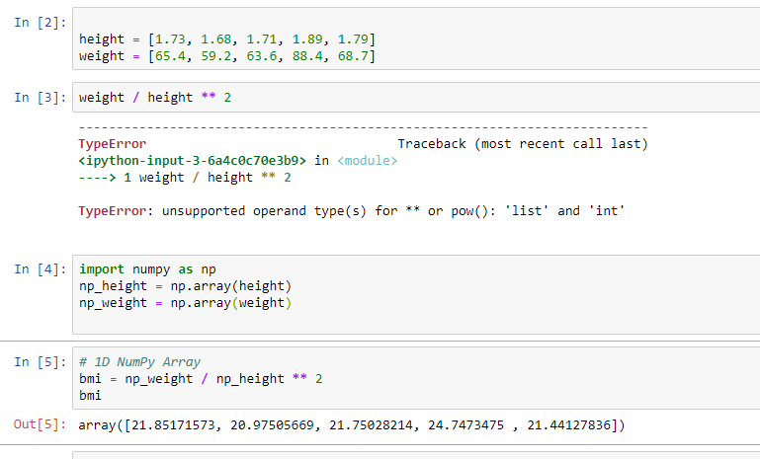
Comparison between NumPy Arrays and Lists
1.3 : Introduction to Python

Slide 5
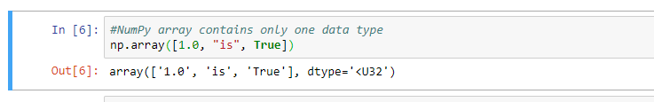
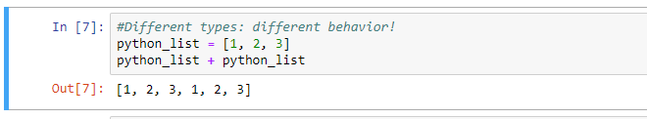
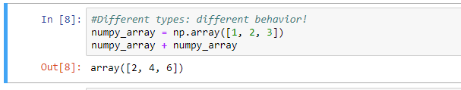
Comparison between NumPy Arrays and Lists
1.3 : Introduction to Python

Slide 6
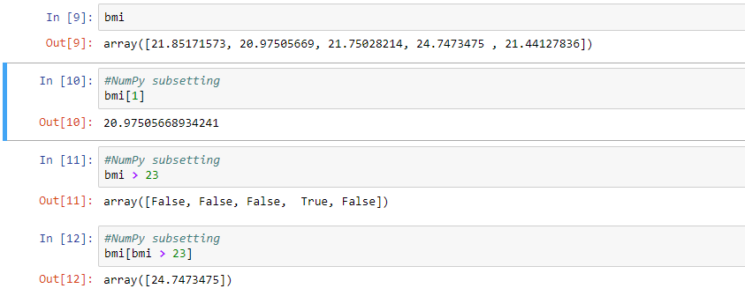
Numpy Subsetting
1.3 : Introduction to Python

Slide 7
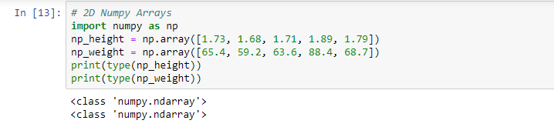
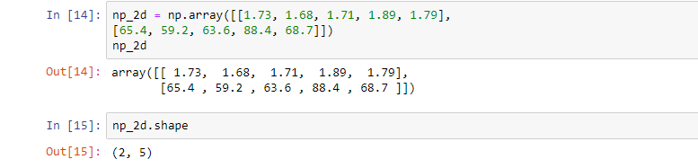
2D Numpy Array
1.3 : Introduction to Python

Slide 8
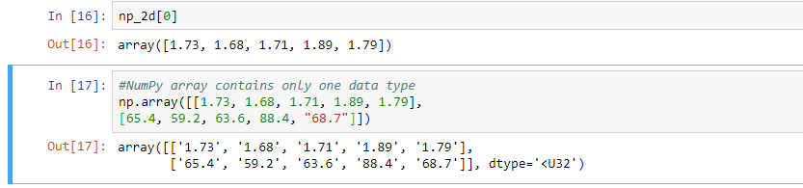
2D Numpy Array
1.3 : Introduction to Python

Slide 9
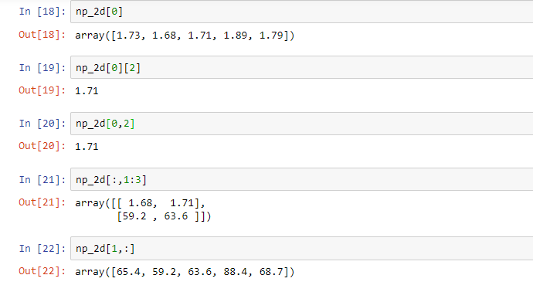
2D Numpy Array- Subsetting
1.3 : Introduction to Python

Slide 10
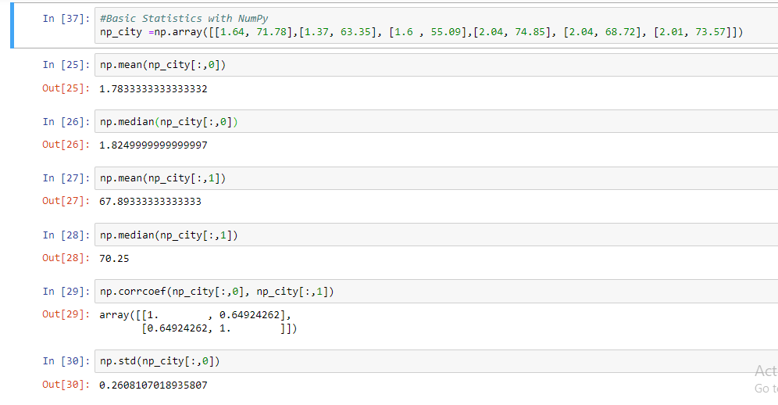
Basic Statistics with NumPy
1.3 : Introduction to Python

Slide 11
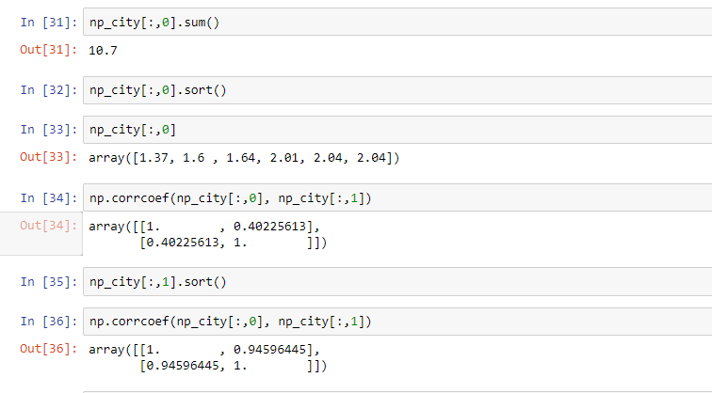
Basic Statistics with NumPy
1.3 : Introduction to Python

Slide 12
Generate Data
Arguments for np.random.normal()
distribution mean
distribution standard deviation
number of samples
1.3 : Introduction to Python

Slide 13
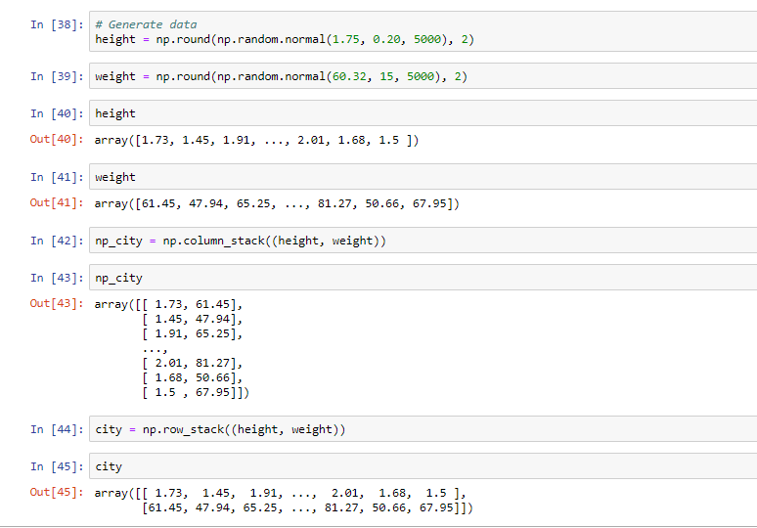
Generate Data
1.3 : Introduction to Python

Slide 14
Let's practice!
1.3 : Introduction to Python

Slide 15
Thank You

